Slide 1
Dependency Graph of Ingress Queue
Flow 1
S1
S2
S1
S2
TX
RX 2
TX
RX 2
RX 1
TX
RX 1
TX
TX
RX 3
TX
RX 3
S4
S3
S4
S3
RX 4
TX
Flow 2
RX 4
TX
A lossless network N and a flow set F.
Dependency Graph of Ingress Queue.
Construction of Dependency Edge: If a flow f traverses two ingress queues i and j in sequence, we add one dependency edge from i to j.

Slide 2
Ingress Associated Buffer Occupancy B_{i,j}(t)
RX i
B_{i,j}(t)
RX j
Switch buffer
switch X
switch Y
Let i be an ingress queue of switch X. Let j be an ingress queue of switch Y. Assuming there is a dependency from i to j. At switch X, B_{i,j}(t) is the instant buffer occupancy of the packets received by i and destined for j at time t.

Slide 3
Three Necessary Conditions for Deadlock in Output-queued Lossless network
Cyclic Routing Condition: there is a cycle (denoted as C) in the dependency graph of ingress queue.
Simultaneous Pause Condition: all the ingress queues in C are pausing their upstream ingress queues in C simultaneously at time t.
Closure Buffer Dependency: for any ingress queue i in C, for any ingress queue j that satisfies B_{i,j}(t) >0, j is also in C.

Slide 4
Experiment Scenario 6
Flow 3, rate limited at circle link to 1/4
RX 5
RX 5
S1
S2
TX-2
TX
RX 2
r₁ = B
S1
S2
Flow 1
TX
RX 2
RX 1
TX
TX-1
RX 1
r₂ = B
TX
RX 3
TX-1
RX 3
S4
S3
S4
RX 4
S3
Flow 2
TX
RX 4
TX
RX 6
TX-2
RX 6
Flow 4, rate limited at circle link to 1/4
Dependency Graph of Ingress Queue.
Necessary conditions 1 and 2 are met. But as B_{4,6}(t) > 0 and RX 6 is outside the cycle, so condition 3 is not met. There will be no deadlock.

Slide 5
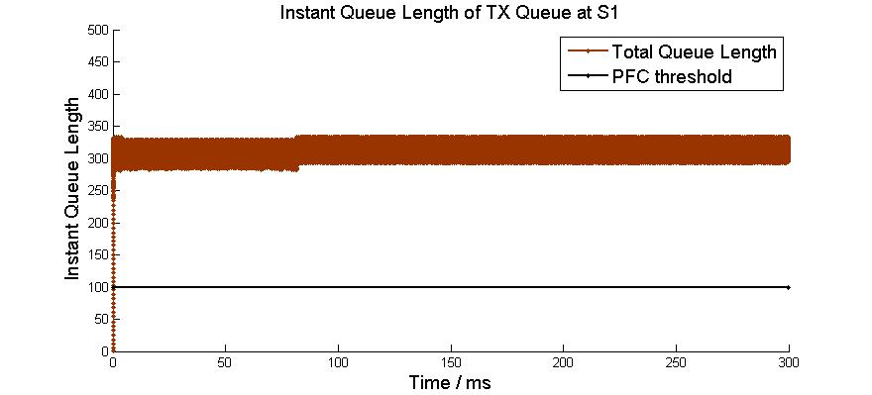
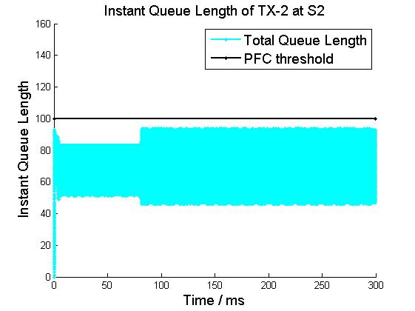
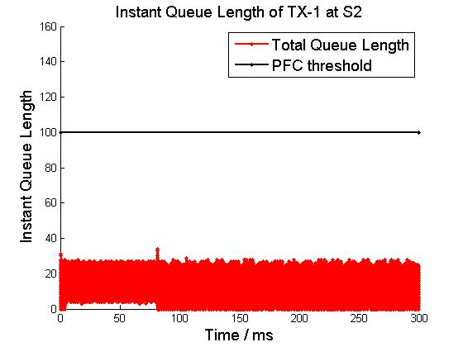
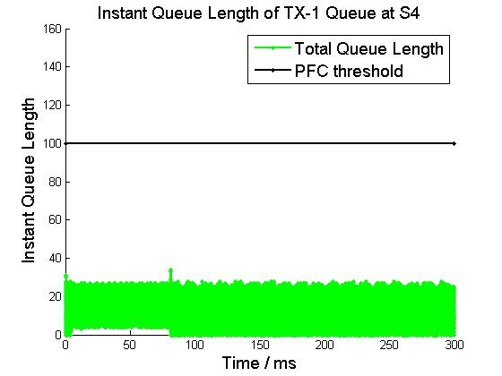
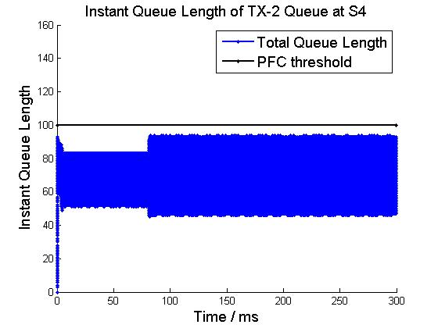
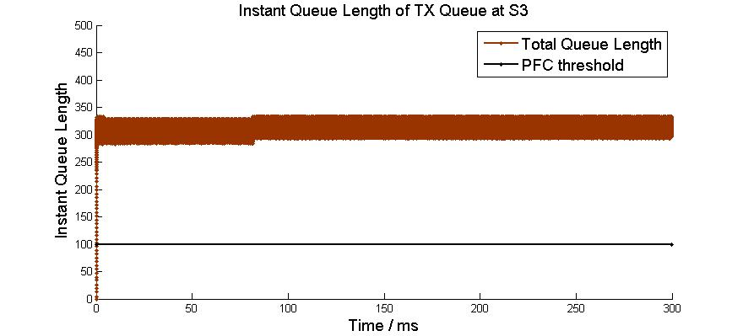
Experiment Scenario 6
TX-2
Flow 3, rate limited at circle link to 1/4
r₁ = B
S1
S2
Flow 1
TX
RX
RX
TX-1
r₂ = B
TX-1
RX
S4
S3
Flow 2
RX
TX
TX-2
Flow 4, rate limited at circle link to 1/4
4-switch 4-flow case

